Slide 1

MSIS2534 Fall 2024
Supervised under Professor Sanjiv Das
Team 6: Jaden Deng, Amy Zhou
Notes:
Hello everyone! We are team 6, I am Amy Zhou. my Teammates is Jaden.
Today, our team are excited to share our project goals and business insights we found based on Google Maps restaurant reviews dataset.

Slide 2
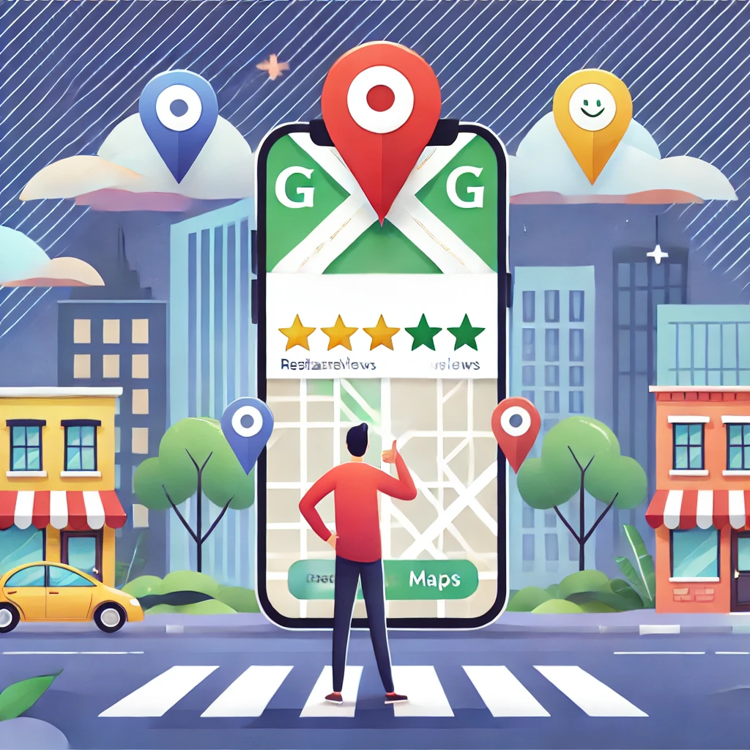
Unlocking Restaurant Trend with NLP
Question:
How many of you use Online Platform reviews and rating to decide where to eat especially in a new city?
Notes:
Let me start by asking a quick question: How many of you use online reviews and ratings to decide where to eat especially in a new city? Please raise your hand!
Looks like many of us do this way! That’s exactly the problem we tackled—understanding restaurant trends and improving customer experiences by leveraging NLP techniques. Let's dive in!

Slide 3
Agenda
Ideation
EDA
Execution of Ideas in Three Dimensions
Sentiment Analysis
Topic Modeling
Predictive Modeling for Restaurants’ Rating
Insights and Recommendations
Notes:
To give the class a clear picture of our project, walk through the framework we used. Our project is divided into four key parts:
Ideation: We started by identifying the problem—understanding customer reviews on Google Maps—and how NLP could provide deeper insights beyond ratings.
EDA (Exploratory Data Analysis): In this step, we cleaned the data, identified patterns, and prepared it for further analysis. This ensured the quality and relevance of our findings.
Execution of Ideas in Three Dimensions:
Sentiment Analysis: We analyzed the emotions and sentiments in customer reviews to understand what drives satisfaction or dissatisfaction.
Topic Modeling: We extracted recurring themes in reviews to uncover what aspects customers frequently discuss.
Predictive Modeling: Finally, we built a model to predict how addressing negative feedback could improve ratings.
Insights and Recommendations: Based on our analysis, we provided actionable insights for restaurants to improve their ratings and customer satisfaction.
This framework allowed us to approach the project systematically, combining data-driven analysis with practical recommendations.

Slide 4
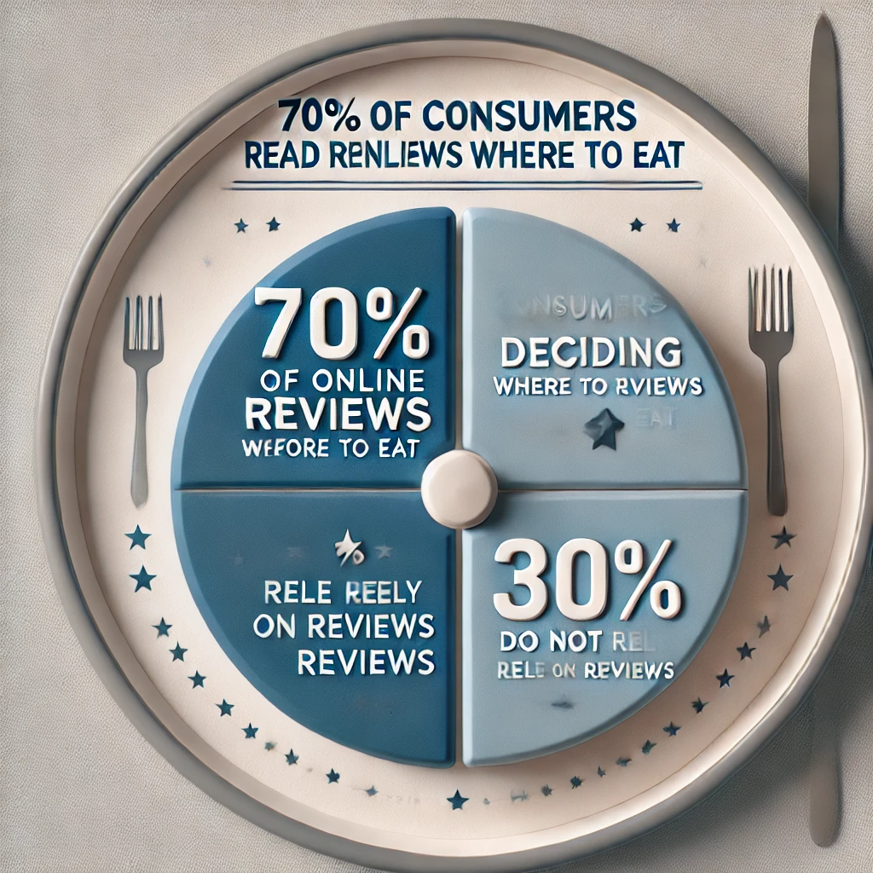
Ideation
Problem Statement.
Why does it Matter?
Customer Impact: 70% of diners rely on online reviews to make dining decisions (BrightLocal, 2023).
Revenue Impact: A one-star increase on Google Maps can lead to a 5-9% increase in restaurant revenue (Harvard Business Review, 2011).
Notes:
The problem we identified is simple but significant. Google Maps reviews are rich in customer feedback, but they are unstructured and overwhelming to analyze manually for restaurant business. Restaurants often don’t fully understand what drives their ratings—positive or negative. And what factors have influenced their ratings. Our team goal is to extract meaningful insights from these reviews to help restaurants improve their services, ratings, and customer satisfaction.
Why is this important? Reviews are not just words—they directly impact a restaurant’s reputation and revenue. Studies show that higher ratings attract more customers and boost sales. By analyzing reviews, we can help restaurants identify customer needs, address common complaints, and ultimately improve their online presence and profitability. This work matters because it bridges customer opinions and business success.

Slide 5
Ideation: How aligned is it with NLP
Unstructured Data Analysis
Keyword Extraction
Real-World Application
Notes:
Our project is perfectly aligned with NLP. Reviews are unstructured text, and NLP techniques allow us to process and analyze this data at scale. From sentiment analysis to topic modeling, NLP gives us the tools to uncover patterns, identify trends, and generate actionable insights. This project demonstrates the power of NLP in solving real-world business challenges, especially in the competitive restaurant industry.

Slide 6
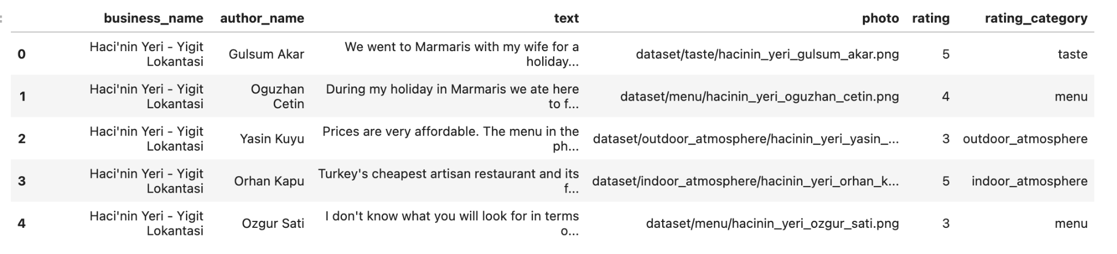
Exploratory Data Analysis (EDA)
Raw Unstructured Dataset
Notes:
Enumerable: rating and rating_category. We have 6 variables in this dataset. We primary focused on text and rating variables analysis.

Slide 7
EDA: Data Cleaning
Remove URLs
Remove special characters and numbers
Tokenize words
Remove stopwords
Lemmatize words
Notes:
After done these data cleaning steps, the dataset is ready to put in our model.

Slide 8
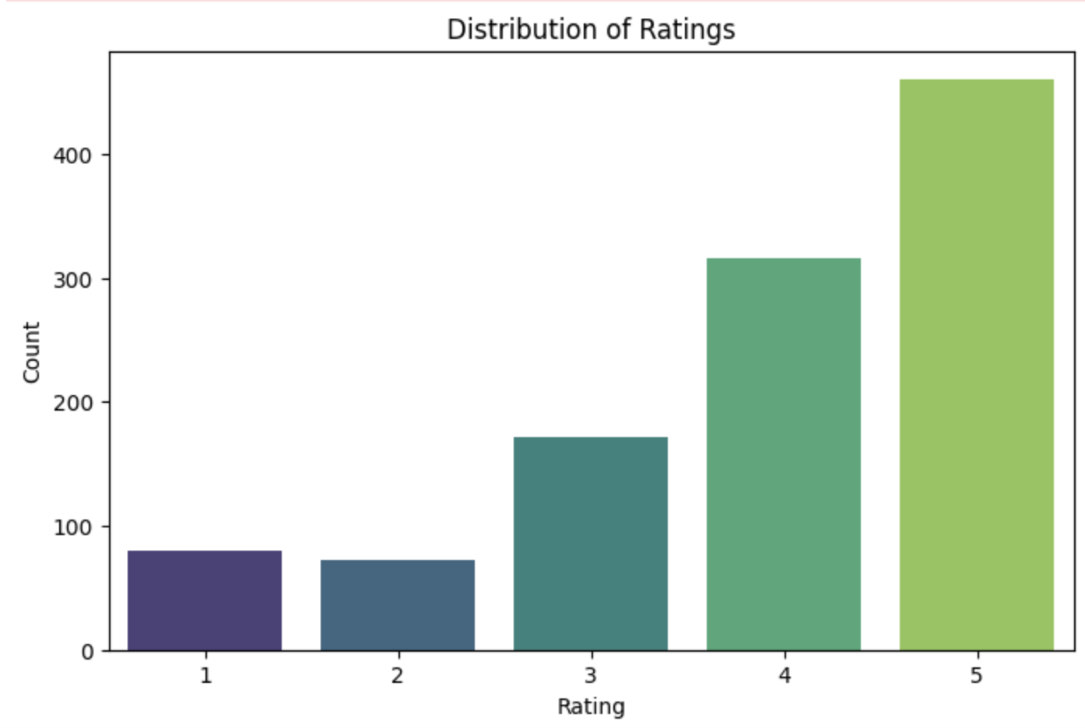
Summary from EDA
Notes:
Key Observations:
"Most of the ratings are positive, with many reviews being 4 or 5 stars."
"5-star ratings are the most common, followed by 4-star ratings. This means most customers had a good experience."
"However, there are also 1, 2, and 3-star ratings, which show that some customers were not satisfied."
What This Tells Us:
"Having many high ratings is a good sign for the restaurants, but the lower ratings indicate there are things that need improvement."
"This variety in ratings gives us a chance to look deeper into the feedback to find out what makes customers happy or unhappy.

Slide 9
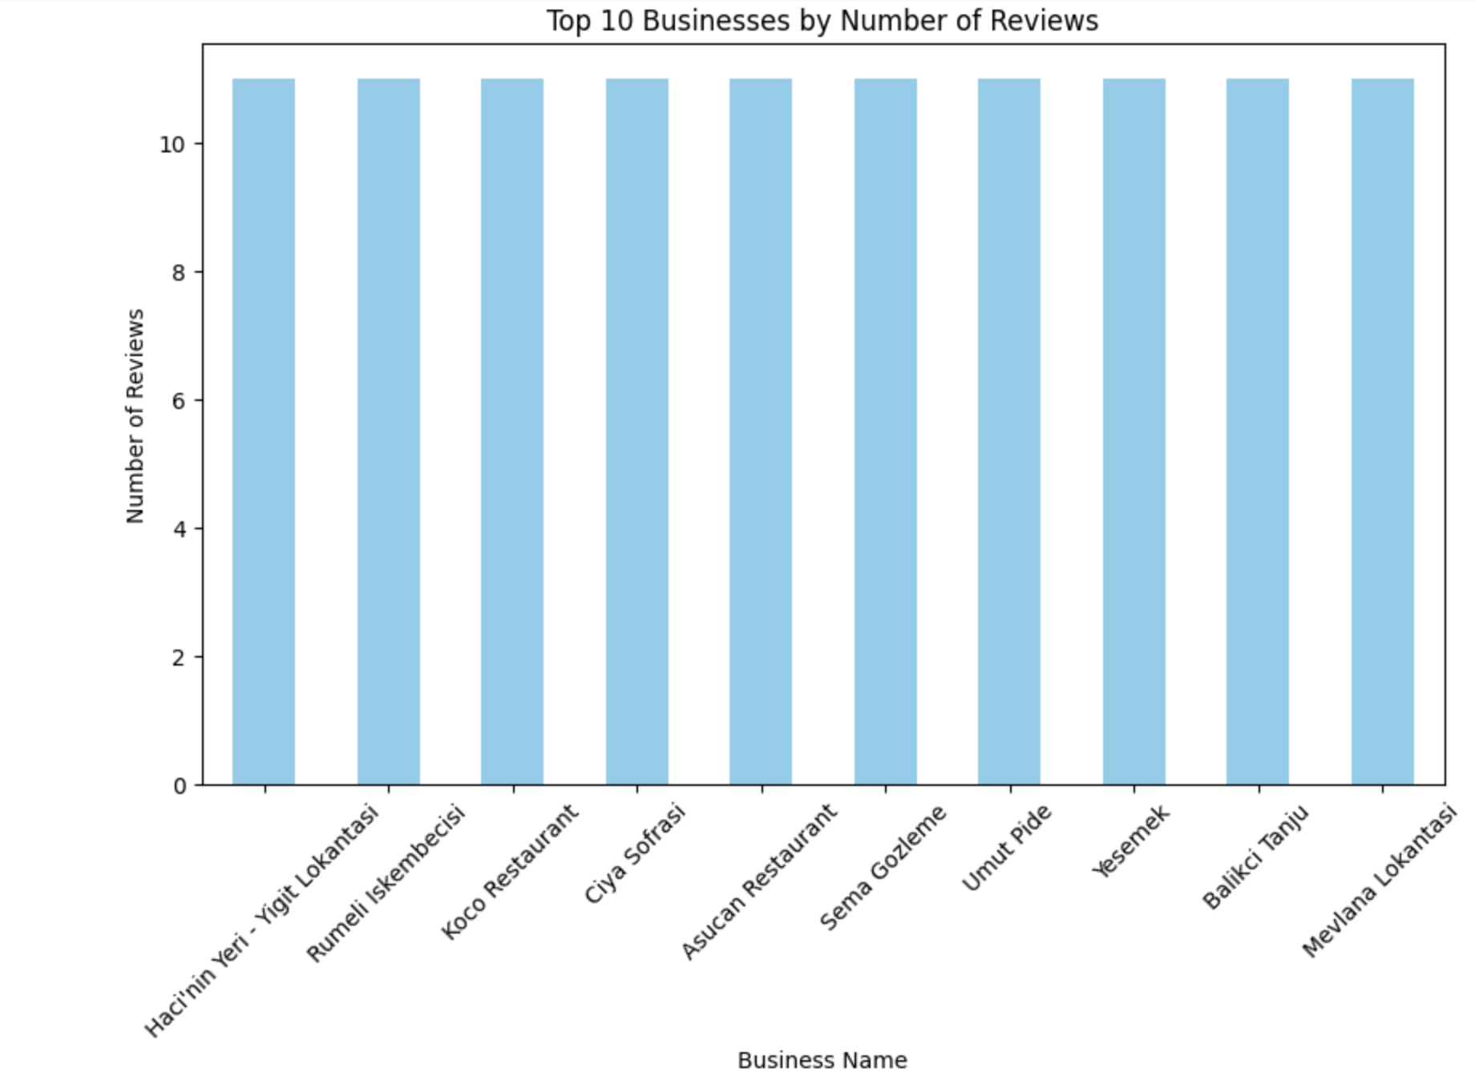
Summary from EDA
Notes:
Here, we plotted the top 10 businesses by the number of reviews. This eda analysis provides insights into which restaurants receive the most customer feedback, which indicated high customer engagement, with an almost equal number of reviews in this visualization. By focusing on these top-reviewed businesses, we can better understand trends in customer preferences and behaviors.

Slide 10
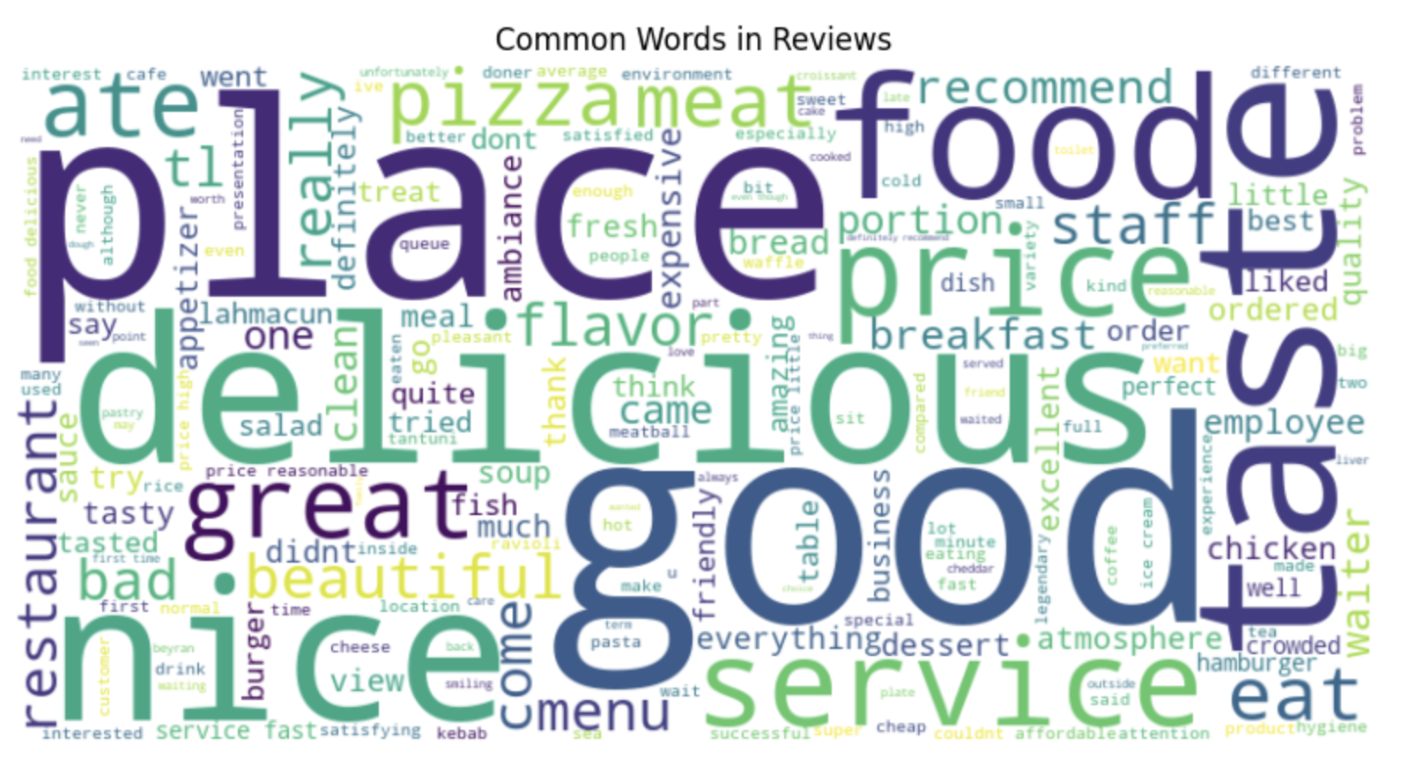
Summary from EDA
Notes:
This word cloud summarizes the most common words from customer reviews. Words like 'place,' 'good,' 'taste,' 'food,' and 'delicious' dominate, reflecting positive dining experiences. On the other hand, terms like 'bad' and 'expensive' also appear, highlighting areas of dissatisfaction. This visual helps us quickly identify the key words
customers talk about, giving us valuable insights into what they value and what needs improvement.

Slide 11
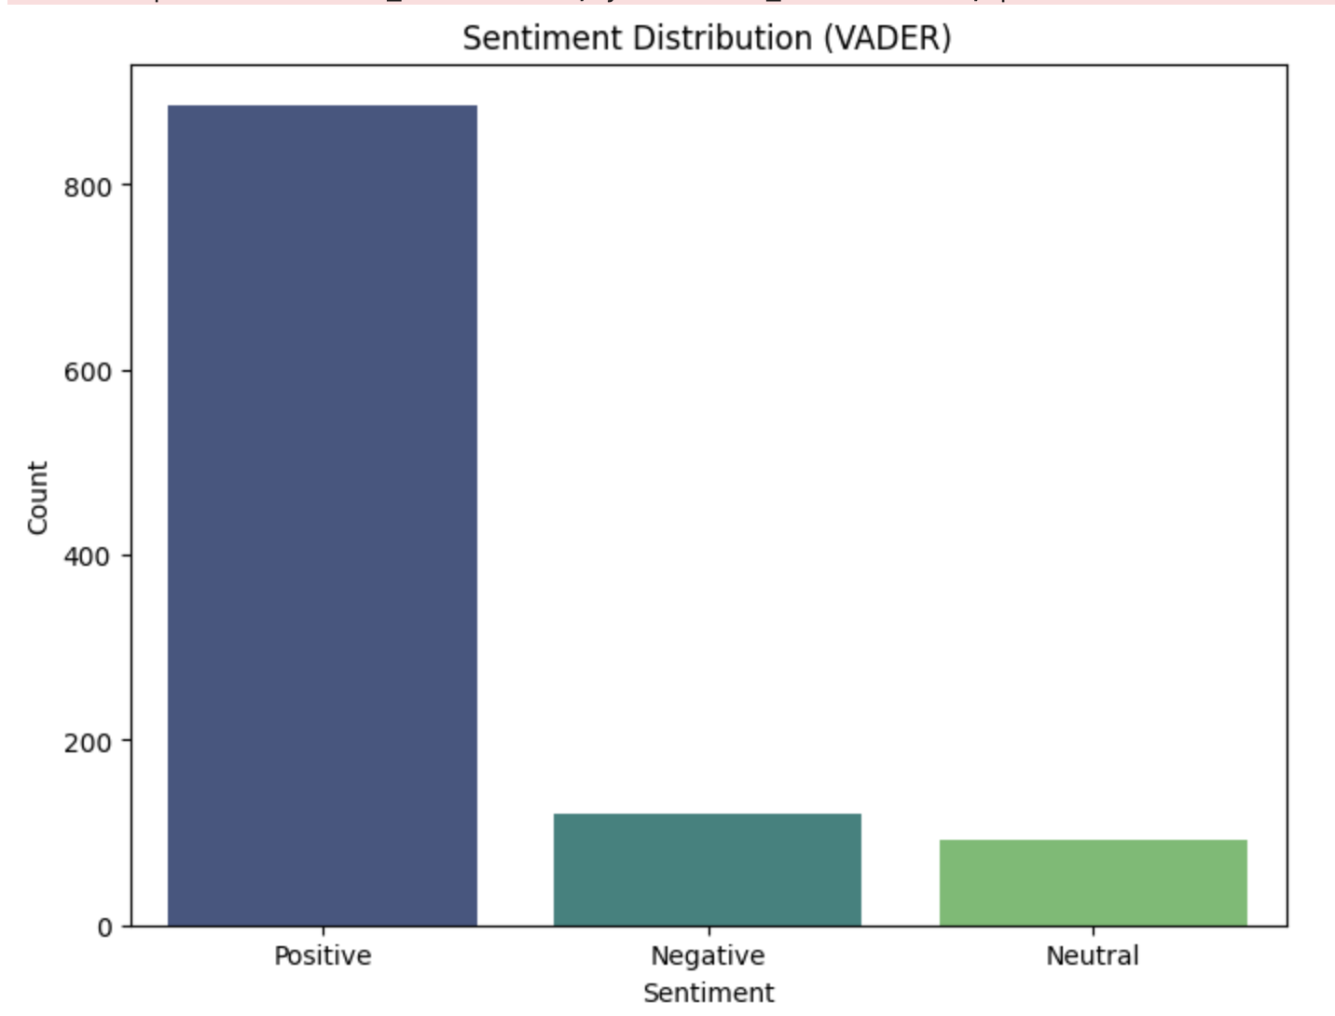
Execution 1: Sentiment Analysis
Notes:
This chart represents the sentiment distribution of restaurant reviews, As we can see, the majority of reviews fall into the positive category, indicating that most customers
had a good experience. Negative and neutral sentiments are significantly smaller, but they still provide valuable insights into areas that need improvement.

Slide 12
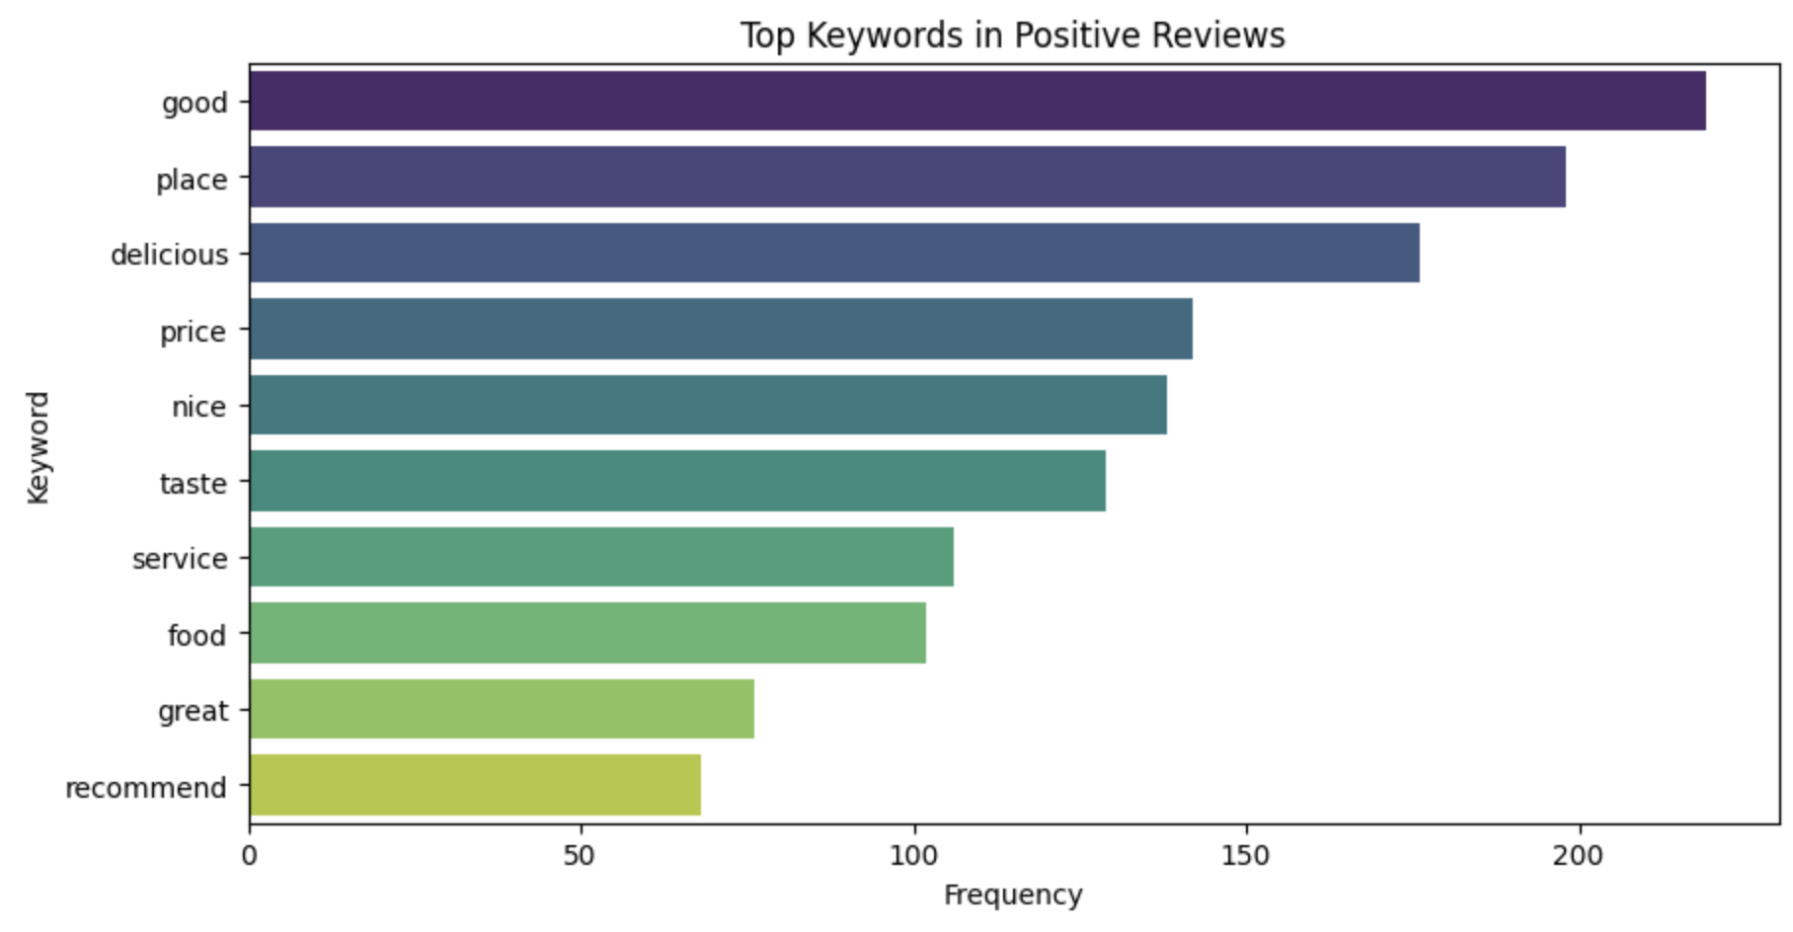
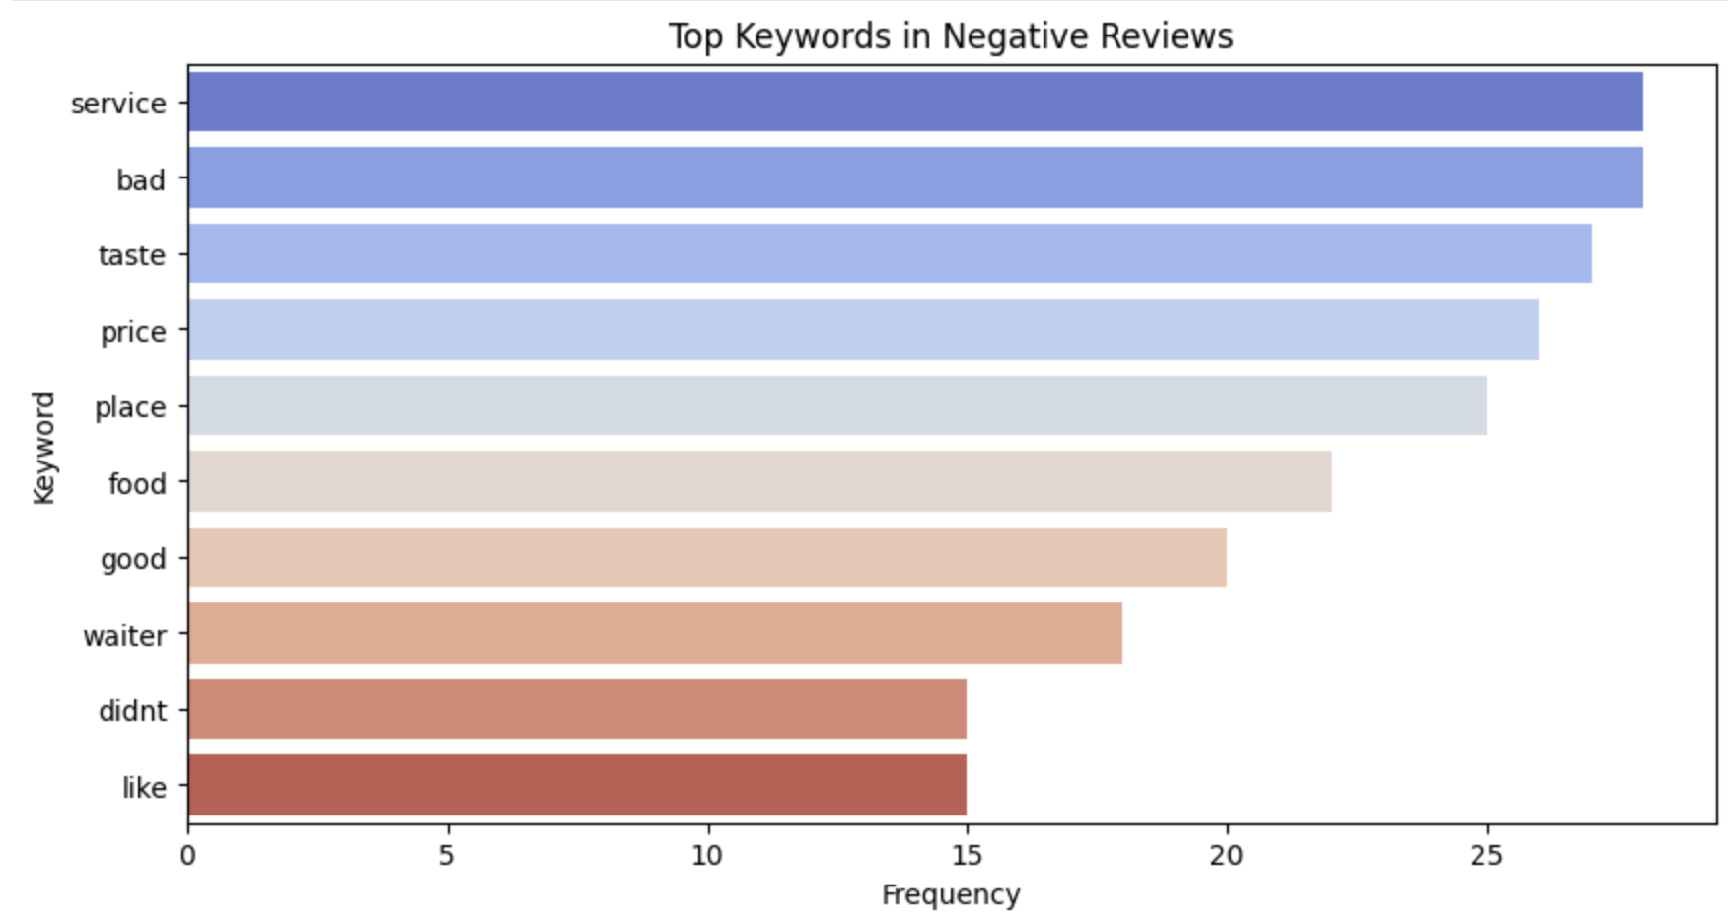
Execution 1: Sentiment Analysis
Notes:
In this step, we conducted sentiment analysis to uncover the customers‘ emotional behind reviews. The results helped us identify key keywords associated with both positive and negative sentiments.
On the left, we see the most frequent keywords in positive reviews. Words like 'good,' 'place,' and 'delicious' dominate, indicating that customers value the quality of food, the restaurant atmosphere, and overall positive dining experiences. On the right, we have keywords from negative reviews. Words like 'service,' 'bad,' and 'taste' stand out, pointing out issues with customer service, unmet expectations, and dissatisfaction with the overall experience. Other terms like 'price' and 'waiter' highlight specific complaints about value for money and interactions with staff.
These insights show that positive reviews focus more on the overall experience, while negative reviews often reflected specific issues, particularly around service and expectations. Addressing these issues provides a clear opportunity for restaurants to improve customer satisfaction and ratings in the future.

Slide 13
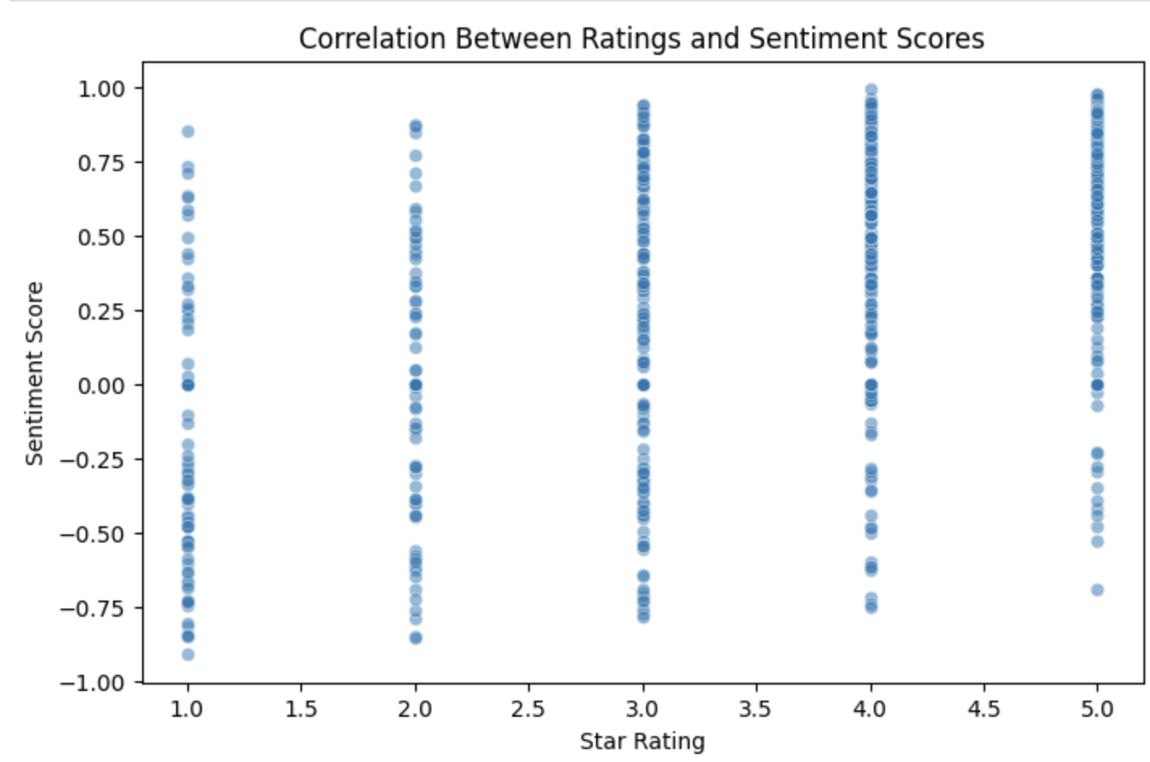
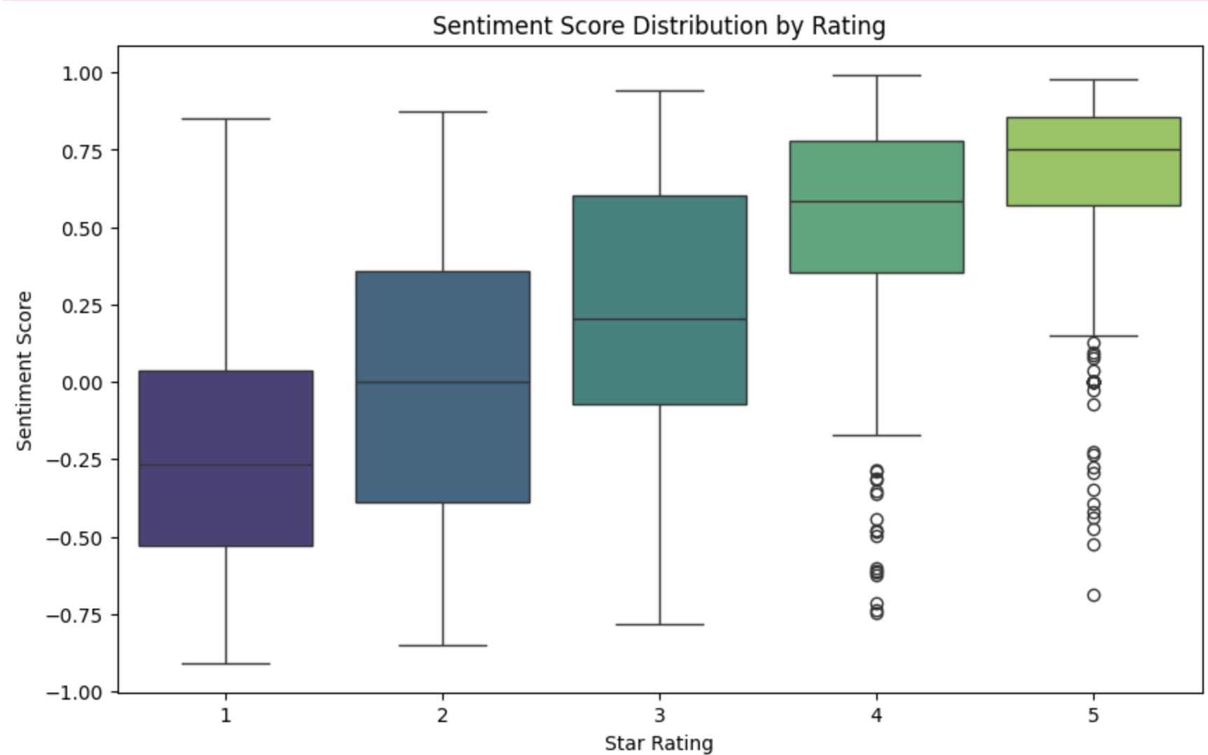
Execution 1: Sentiment Analysis
Notes:
Here, we analyze the relationship between star ratings and sentiment scores. On the left, the scatterplot shows a clear positive correlation—higher ratings generally have higher sentiment scores. On the right, the boxplot highlights the distribution of sentiment scores by rating. As expected, 5-star ratings have the highest sentiment scores, while lower ratings tend to cluster around negative or neutral sentiment. This finding helps confirm that sentiment analysis aligns well with customer feedback, providing a deeper understanding of rating patterns.

Slide 14
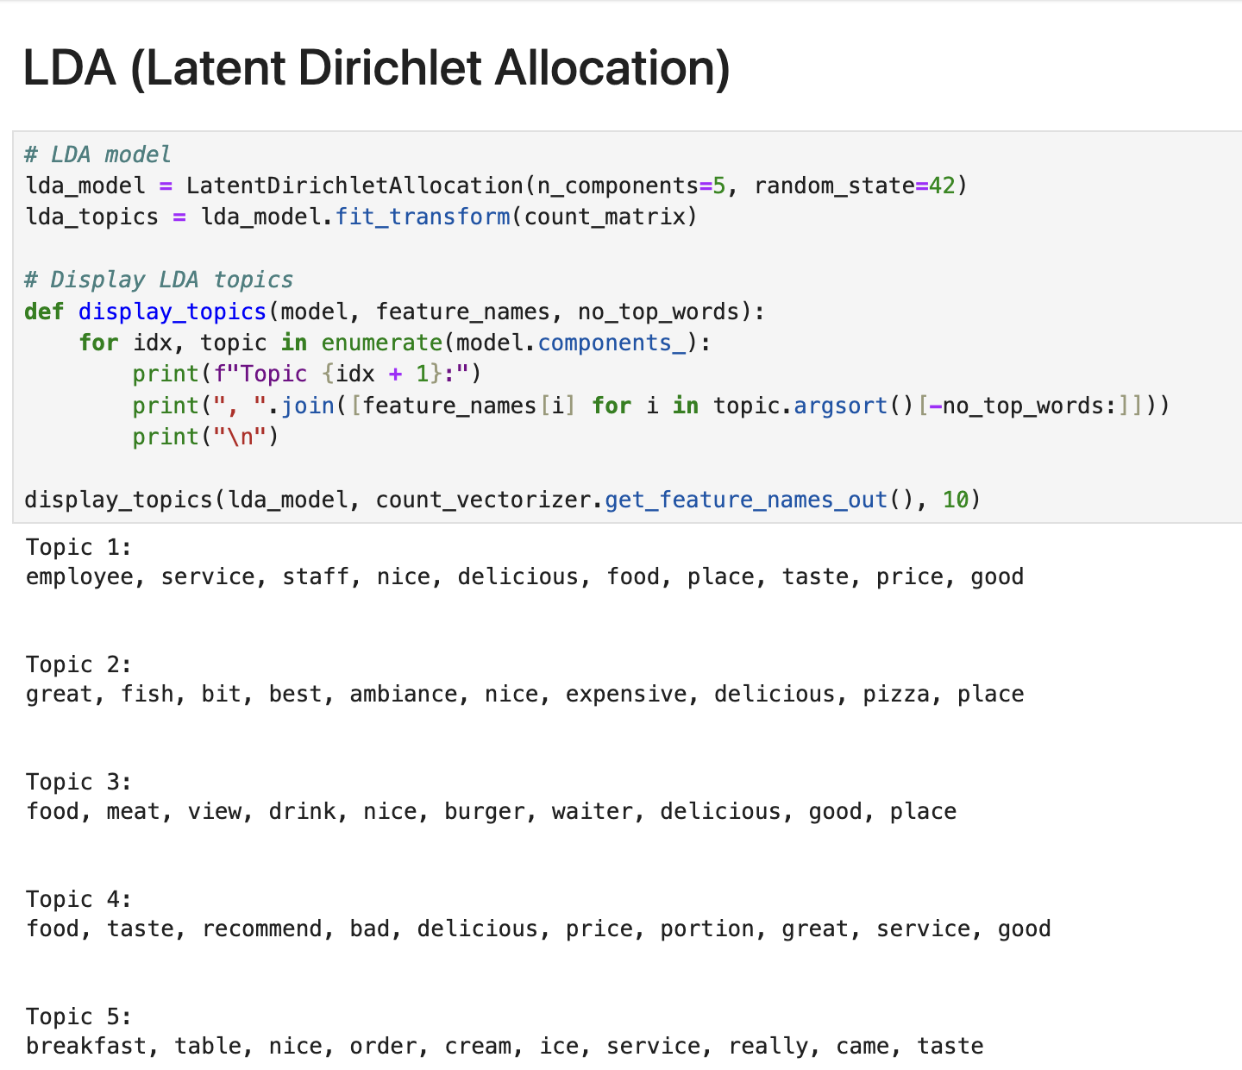
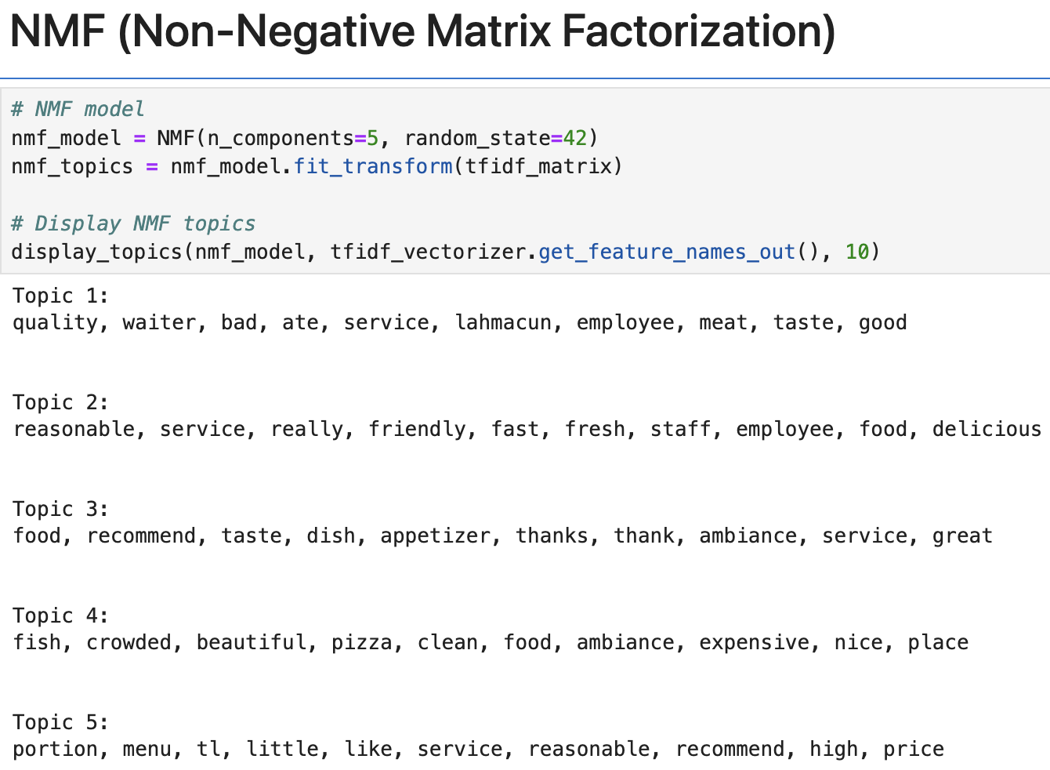
Execution 2: Topic Modeling
Notes:
We used two approaches for topic modeling, both of which generated five topics. The classification results indicate that LDA tends to summarize "core areas of customer experience," such as "service" and "food quality," while NMF is more likely to capture "specific feedback," such as "wait staff efficiency" or "restaurant menu”.

Slide 15
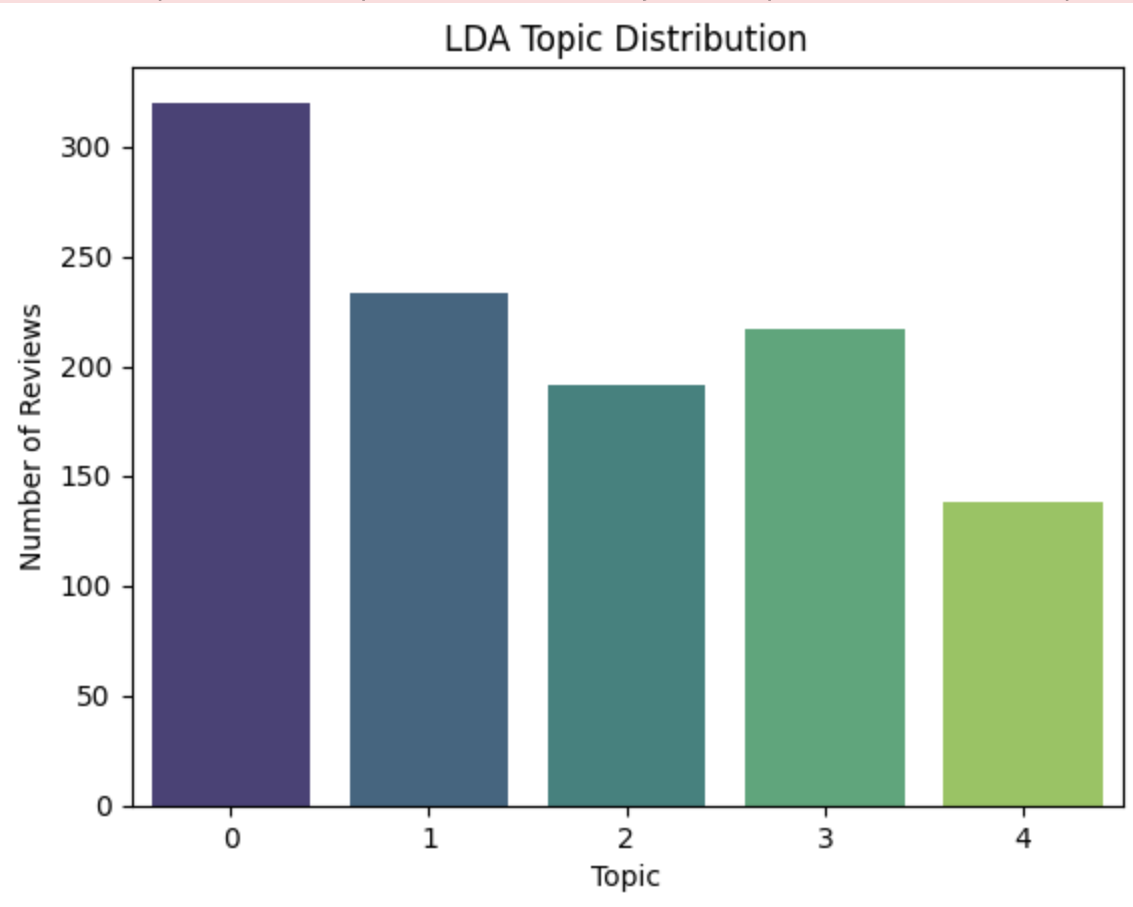
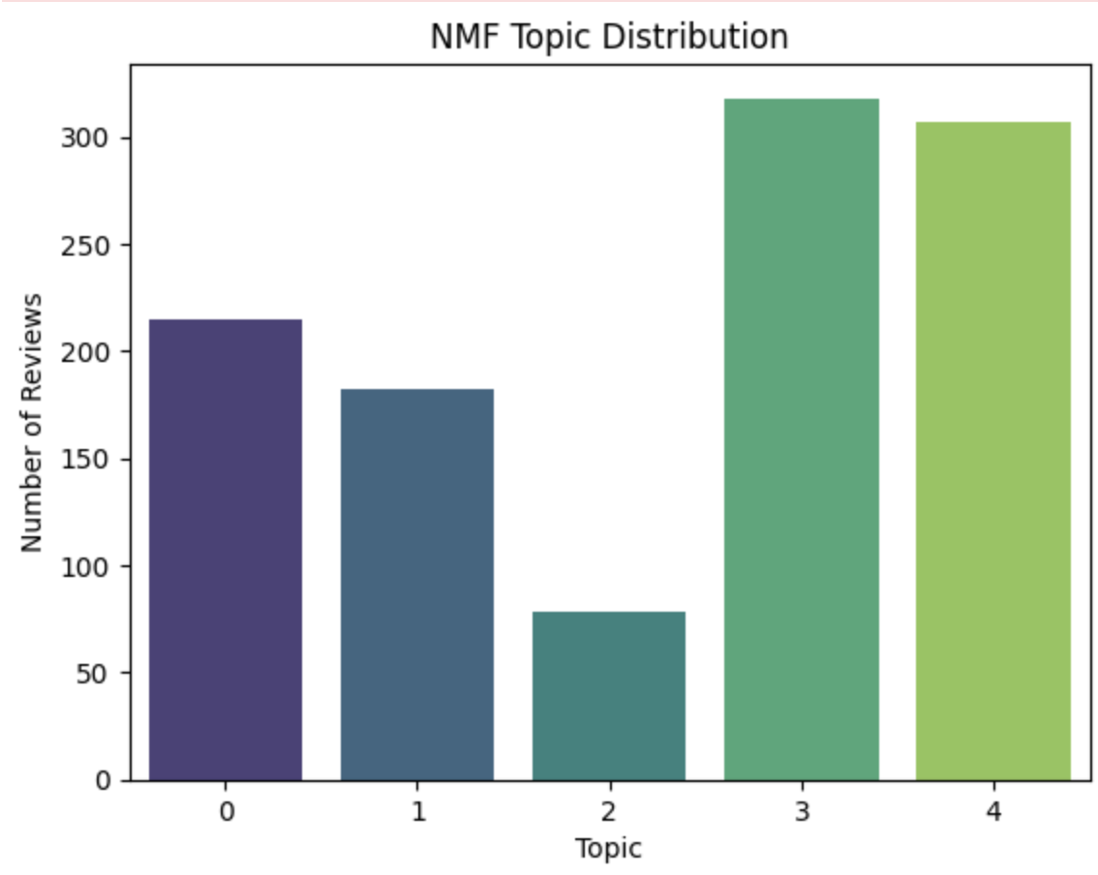
Execution 2: Topic Modeling
Notes:
Here, we are compared the topic distributions generated by LDA and NMF models.
On the left, we see the LDA topic distribution, which shows a more balanced spread across all five topics, with Topic 0 having the highest number of reviews.
This suggests that LDA clusters reviews evenly around broad themes.
On the right, the NMF topic distribution indicates a higher concentration in Topics 3 and 4. This implies that NMF tends to focus on specific aspects or feedback clusters.
This comparison highlights how different models group the data. LDA is effective for identifying broad themes like customer experience, while NMF provides more insights into specific feedback areas. Businesses can choose the model based on whether they need high-level themes or actionable, detailed insights."

Slide 16
Insights & Recommendations
Focus on keywords : Positive and Negative words for strengthen and improve.
Sentiment score highly correlated with review ratings
Use LDA for strategic, high-level improvements
Use NMF for targeted changes to address specific customer complaints.
Test both approaches by analyzing their impact on metrics like customer satisfaction or revenue growth to refine the choice.
Notes:
First, we recommend focusing on keywords. By identifying the most common positive and negative words in reviews, businesses can strengthen what works well and improve areas of concern."
Second, we found that sentiment scores are highly correlated with review ratings. Businesses can use this to prioritize addressing customer pain points highlighted in negative feedback."
Third, LDA is useful for strategic, high-level improvements. It helps identify overarching themes like service quality or overall experience."
Next, NMF is great for targeted actions. It provides specific feedback, such as issues with staff efficiency or restaurant ambiance, allowing businesses to implement precise changes."
Lastly, we suggest testing both approaches. Businesses can analyze their impact on metrics like customer satisfaction or revenue growth to refine their strategy over time.

Slide 17
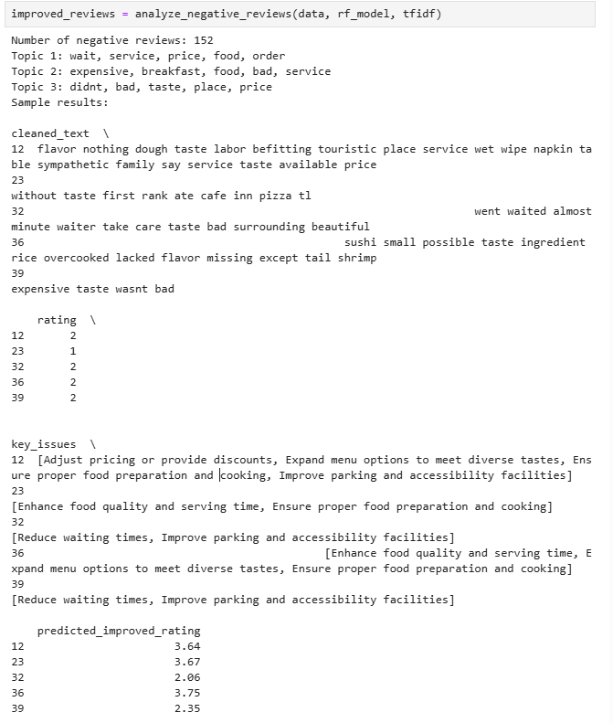
Predicted Rating Improvement
Objective: The key of this part is to predict how ratings would change if these critical issues were fixed. To analyze negative customer reviews (rating <= 2), identify key issues with Spacy embeddings, KeyBERT, and VADER, and predict potential rating improvements with Random Forest Regressor based on suggested actions.
Methodology:
Use methods such as VADER, LDA, Spacy embeddings, Zero-shot classification, and KeyBERT to identify key issues in negative reviews.
Combine the original review with key improvement suggestions to create modified reviews.
Train a Random Forest to predict improved ratings after addressing key issues, which are the reviews after improved.
Directly show changes in ratings before and after improvements, demonstrating that addressing key issues leads to higher ratings.

Slide 18
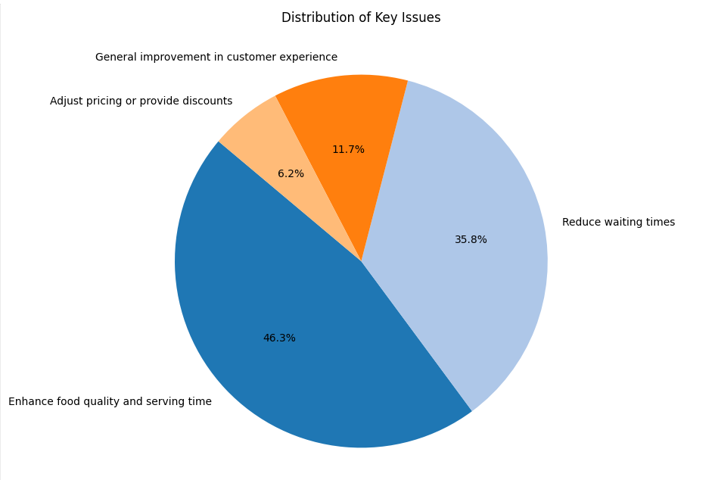
Data Visualization
The pie chart highlights the key issues from negative reviews, with "Enhance food quality and serving time" (46.3%) and "Reduce waiting times" (35.8%) as the top concerns. It provides a clear focus for prioritizing improvements to maximize customer satisfaction.

Slide 19
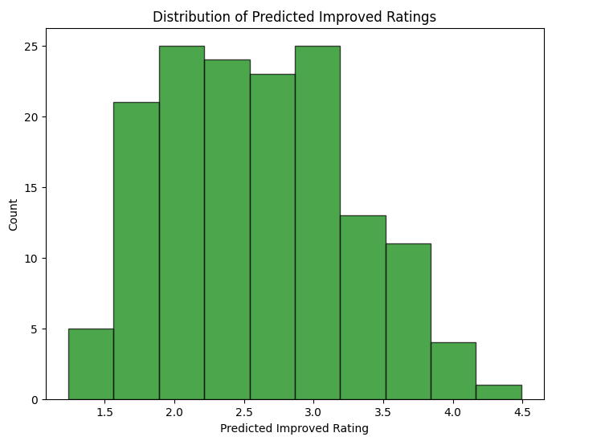
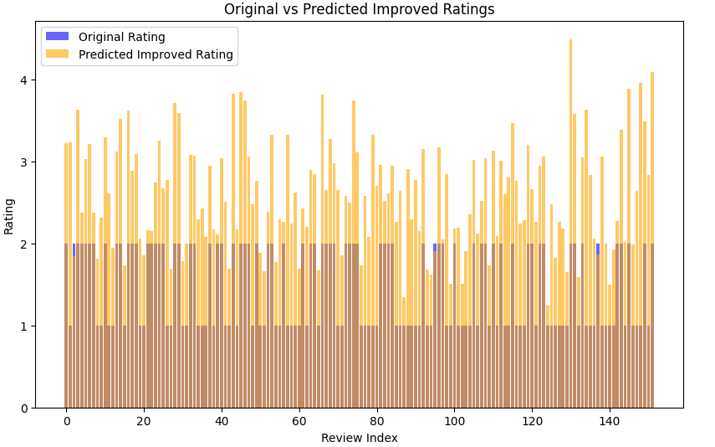
Data Visualization
The histogram shows the distribution of predicted improved ratings after addressing key issues found in negative reviews. Most reviews are predicted to improve to a range of 2.0 to 3.5, with a small number exceeding 4.0. This highlights the potential for significant customer satisfaction improvements if these issues are resolved.
The bar chart compares original ratings (blue) with predicted improved ratings (orange) for individual reviews. The consistent increase in predicted ratings shows how the model identifies actionable changes that directly improve customer experiences. These visuals emphasize the effect of combining NLP and machine learning to predict and drive better customer satisfaction outcomes.

Slide 20

Conclusion
Through exploratory data analysis (EDA), we prepared and analyzed the dataset, uncovering patterns in reviews. And predictive modeling was applied to estimate rating improvements based on suggested actions.
The predicted rating improvements demonstrated significant potential for enhancing customer satisfaction. By addressing key issues such as food quality and waiting times, ratings showed an upward trend, with many reviews projected to improve by 2-3 points. This highlights the effectiveness of targeted strategies derived from customer feedback.
On the other hand, the dataset is focused only on negative reviews(<=2), which may limit the scope of insights. In the future, incorporating neutral and positive reviews would provide a more balanced perspective. Additionally, adopting advanced feature, such as Sentence Transformers, could enhance model accuracy. Also with API or dashboard, would allow for continuous monitoring and real-time analysis of customer feedback.

Slide 21
Thank you for Listening
Any Questions?

